Slide 1
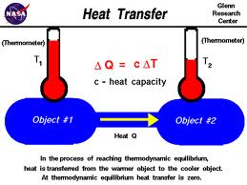
Transmission Of Heat

Slide 2
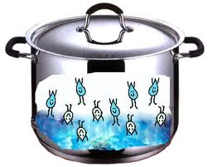
The capacity to do a work is called as energy . Heat is a form of energy. Heat helps in cooking food. Heat makes steam of water in a pressure cooker. Due to pressure of steam the lid moves and the cooker whistles. Steam goes out. This means heat gives energy to water.

Slide 3
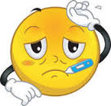
To know the quantity of heat in water or any item , we count the ‘temperature’. Temperature is quantity of heat in an item.
Ice is colder then plain water. Plain water is colder then warm water. Warm water is colder then hot water. We know the difference in hotness of items by touching , but we cannot count it.
Temperature helps in knowing the difference .

Slide 4
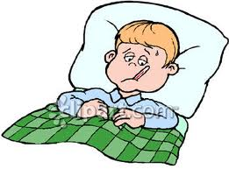
When you have fever ,the heat in your body is more then it’s normally. We cannot say the temperature of our body as hot , cold , more , less because the whole body does not have same temperature.

Slide 5
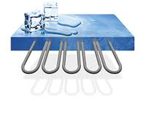
As water flows from higher level to lower level , similarly heat also flows . There are three types of heat transfer.
Conduction – Steel spoon kept in a pot on a burning gas , after some time the other end of spoon becomes hot . This means heat transfer from one end to other end. Transferring of heat from one end to other end in an item is called as conduction of heat.

Slide 6
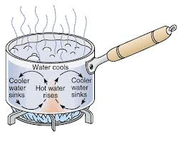
The object through which , heat is travelling is called as medium. Heat can transfer through metal easily. It is good conductor of heat. Metals are use widely as good conductors. Ex. Cooking utensils , boilers used in industries , medical utensils used for sterilization.

Slide 7
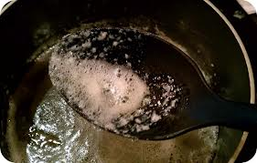
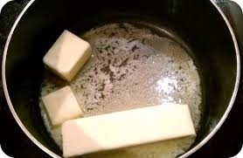
Heat conduction needs medium to transmit heat. Medium is made up of small particles. During conduction particles does not move. It vibrates and pass the heat to next particle . This is the way heat is transferred in conduction from one end to other end. The speed to conduction depends on medium. Conduction is mainly through solid medium.

Slide 8
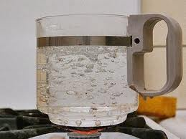
Convection of heat – Take a cup of water and heat it , water at the bottom becomes hot. Hot water is very light and it rises to the surface of water. Cold water inturn takes its place and becomes hot.

Slide 9
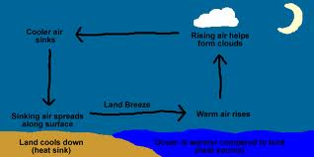
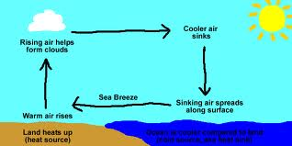
The heat is a bottom-up flow of immigrants. This is called the circulation flow streams . This process of heat circulation or circulation flow of immigrants is called thermogenesis.

Slide 10
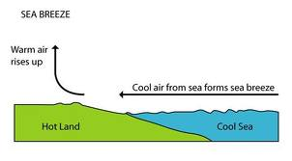
Liquid and gas or liquid media is required for convergence . In circulation process medium grain might leave the place of the original . In convergence circulation stream takes part . Salty wind , wind material are an examples of convergence gas medium .

Slide 11
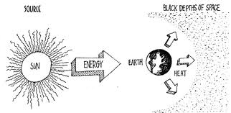
Heat radiation – The distance between sun and earth is millions of kilometers. There is not any liquid or gas present between the sun and the earth, except air . But the heat of the sun reaches the earth . The transfer of heat in the absence of medium is called as migration of heat or heat radiation.

Slide 12
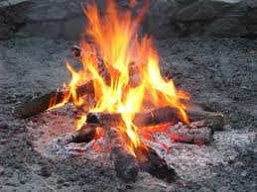
Hot air around the vessel to be hot, feeling warmness of fire without putting your hand in the fire , are examples of transfer heat through emission/radiation .

Slide 13
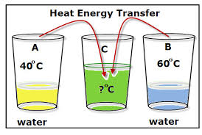
Heat transfer from higher temperature towards lower temperature. Each hot item ( solid, liquid, gas) emits heat to all sides . If emitting heat comes in contact of other heat - emitting surface / materials , some of the heat is absorbed , some of the heat is reflected. If heat is absorbed , its temperature increases.

Slide 14
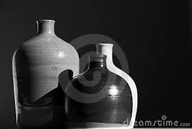
The majority of the white color reflects heat where as black color absorbs heat. So the clothes in summer are white colored and in winter dark colored clothing is comfortable to use . Since black color absorbs heat , pots used in solar oven are colored black from outside and the solar oven is colored black from inside.

Slide 15
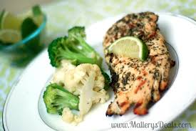
Hot substances always radiate heat in the form of heat radiation . Due to this after some time the heat in the item becomes less.
It means temperature of item decreases. We say the item is cooling down or cool.

Slide 16
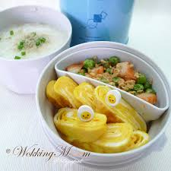
Very cold or chilled item if kept in environment, the item absorbs heat from the atmosphere or environment, so its temperature increases. But sometimes it is necessary to retain the temperature of foods.

Slide 17
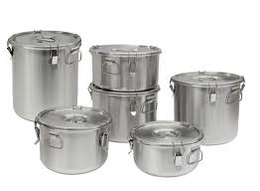
While taking Tea - Coffee or soup to patient in the hospital , it may become cold. It cannot be heated again. Hence thermos flask is used to keep it hot.

Slide 18
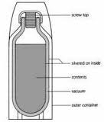
The structure of Thermos flask is like two thin glass bottles fixed in one another with some distance in two layers. The inner part is shiny like mirror . Vacuum pump removes the air holding space between two layers. The glass bottle is fit into the plastic bottles, and a plastic lid is used to cover.

Slide 19
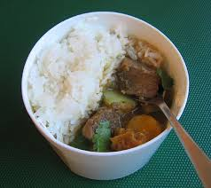
Work of Thermos - The vacuum in the two layer of glass bottle does not allow flow of heat either by transmission or conduction. Surface like mirror reflects heat inside emitted by item.

Slide 20
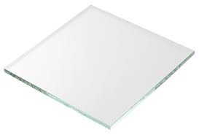
Glass and plastic are bad conductors so heat does not get transmitted through them. Due to this the heat cannot be transmitted either from inside to outside or outside towards inside .

Slide 21
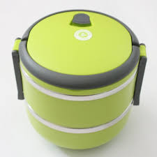
Heat can not be transmitted either from inside to outside or vice versa by convection, conduction and radiation . Due to this interior food remains hot if hot item is there or cold if cold item is present inside box.

Slide 22
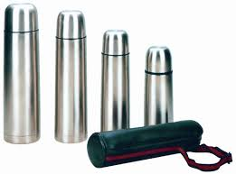
Now a days to keep food hot ‘ thermo ware ‘ utensils are used. The outer cover is of plastic and the inner layer is of steel. The space between two layer contains air.

Slide 23
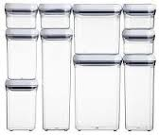
Air is a bad conductor of heat . Thus heat cannot be transmitted from inside to outside. Shinny inner surface reflects heat back inside. The cap is of plastic. Plastic is bad conductor of heat ,hence the hot item remains hot for a long time.

Slide 24
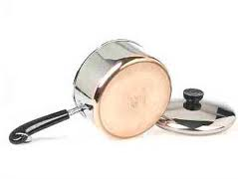
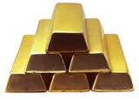
Some of the substances does conduction of heat easily and quickly , they are called as good conductor of heat . E.g. Iron , copper and other metals.

Slide 25
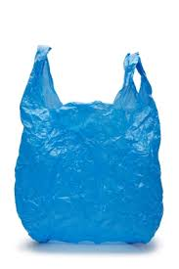
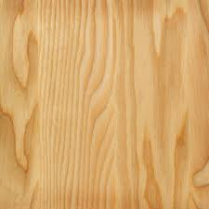
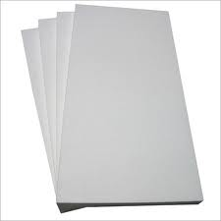
Some of the substances does not allow heat conduction from the substances easily and rapidly. Such substances are called slow heat carrier or bad conductor .
E.g . Plastic , glass , wood, thermocol etc . You might have seen snow kept in wooden case which does not allow ice to melt quickly. We have seen cooking spoons have wooden or plastic handles.

