Slide 1
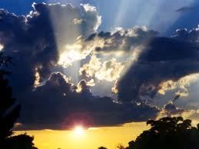
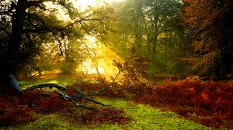
Propagation of Light

Slide 2
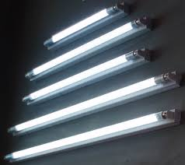
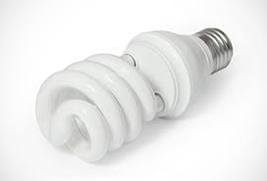
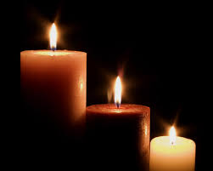
During the day time we can see many things around us in the presence of sun light but in the night we use CFL , tube light or candle to see the things around us.
We can see the things around us due to ‘reflection of light ‘.

Slide 3
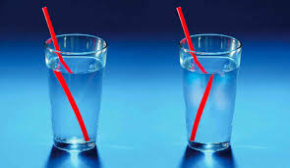
The ray of light can pass through transparent material like glass but cannot pass through non-transparent material like wall , stone.
If a ray of light falls on non-transparent thing , it changes it’s path. This process is called as reflection of light.

Slide 4
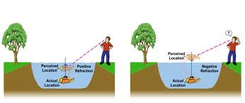
We see any thing in the presence of light , following are the steps how we can see it.
1) Sun light or ray of light from any other source falls on item or thing.
2) If the item or thing is non-transparent the ray of light changes its path or light if reflected.
3) Such reflected rays reach to our eyes.
4) We see the part of a thing or item from which the light is reflected .

Slide 5
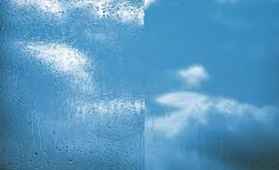
This is why , if the glass of a window is clean , we cannot see the glass of a window, but we can see the world outside from the window.

Slide 6
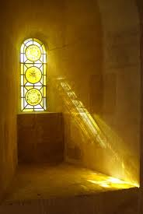
If you see a beam of light entering through the roof or slight of door , you observe dust particles moving randomly
The straight beam is observed because of presence of dust particles.
This means the ray of light travels in straight line . This is called as propagation of light.
Light travels in straight line. Travelling of light in straight line is called as linear propagation of light.

Slide 7
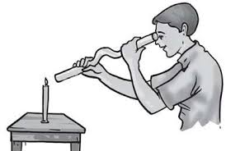
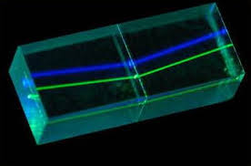
We can observe propagation of light from some of following experiments.
The laser torch gives a fine beam of light.
Take a 1 feet long plastic tube and see through it . Now bend the tube a little , and see through it.

Slide 8
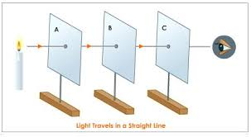
Take three square pieces of cardboard and place at some distance in a row. Make a fine hole exactly in the centre of each of the pieces. Place a lighted candle at one end in front of the hole. Now look through the hole at the other end. Observe when holes are in a line , When holes are not in a line.
Observe the light of torch.
Observe umbra (dark shadow) cast by a point source of light.

Slide 9
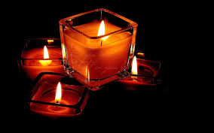
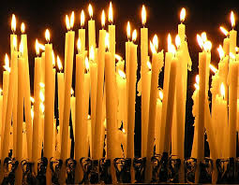
You can obtain a shadow cast by a point of light. Use following steps.
Remove one side of a box and cover the side or stick with white thin kite paper .
Make a hole on the opposite side .
Color the box inside with black colour.
Place a burning candle in front of the hole , outside the box.
Now you will get upside down image of the flame on the kite paper.

Slide 10
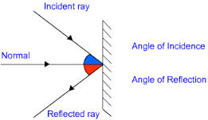
If a ray of light raveling in straight line, falls on any object or non-transparent thing, the ray cannot pass through it. The other side of the object remains in dark, which has the same shape as of the object. This dark part is called as shadow of the object.

Slide 11
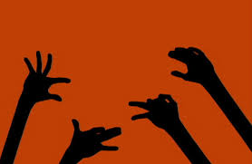
To get shadow, the source of light or the rays of light, the object and the screen’s place, on which you want a shadow need to be in a line. The object should be in between the source of light and the screen. We can see the shadow of our fingers on the wall.

Slide 12
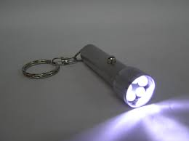
To do more study of creation of shadow we can use a point source of light. Take a non-transparent plane cardboard and make a pin hole in the center. Place a torch on bulb of light. Now look from the opposite side of the cardboard, you will see the light of rays coming from the hole, as if it is coming from a point. This is called as a point source of light, very limited rays of light can come from a point source of light.

Slide 13
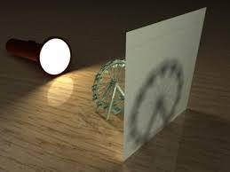
The source of light is big or extended, we get different types of shadow. If the source of light is a point, we get complete dark shadow on the screen.

Slide 14
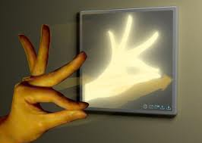
If extended source of light is used, we get two shadows of the object, dark in the center and faint at the outer side. The dark shadow is called as Umbra, and the faint shadow is called as Penumbra.

Slide 15
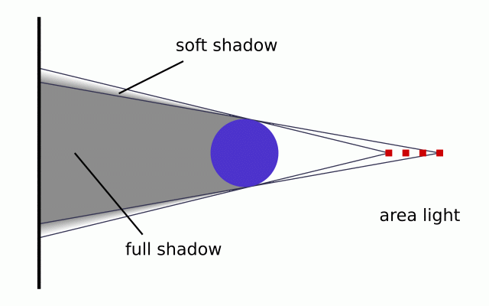
If the distance between the extended source and the screen is increased gradually, you get the umbra fainter. At a specific distance, umbra completely disappears and gets mixed with penumbra.

Slide 16
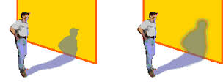
Imagine – The aeroplane, birds flying are the object, the sun is the source of light and earth is the screen. The distance between the screen and object is more, due to this aeroplane or a bird does not cast a shadow when they are very high above the earth.

Slide 17
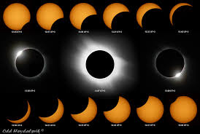
The solar eclipse and lunar eclipse are examples of creation of shadow. If the earth comes in between the sun and moon, and three are in a straight line, the shadow of earth falls on the moon and a lunar eclipse takes place. If the moon comes between the sun and earth, the shadow of moon falls on earth, we say that a solar eclipse has taken place. If the sun is partially covered, we say partial solar eclipse. If the sun is completely covered, it is called as solar eclipse.

Slide 18
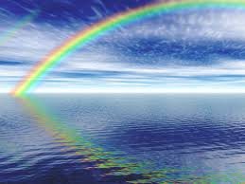
Eclipse are occurring in the sky due to sunlight. Another thing we see due to sunlight is rainbow. If the rainbow falls on and a ray of light pass through it, due to specific shape of rain drop. The colors in the light are separated/scattered. We see orange, yellow, green, blue, indigo, red and violet. This is called as spectrum.

Slide 19
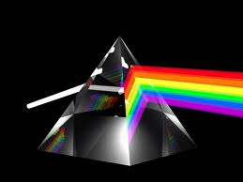
Make sure the room is dark enough. Through the hole in the cardboard, allow the sunbeam to fall on the prism at a slant. Now look from the other side. You will see a band or seven colors called the spectrum.

Slide 20
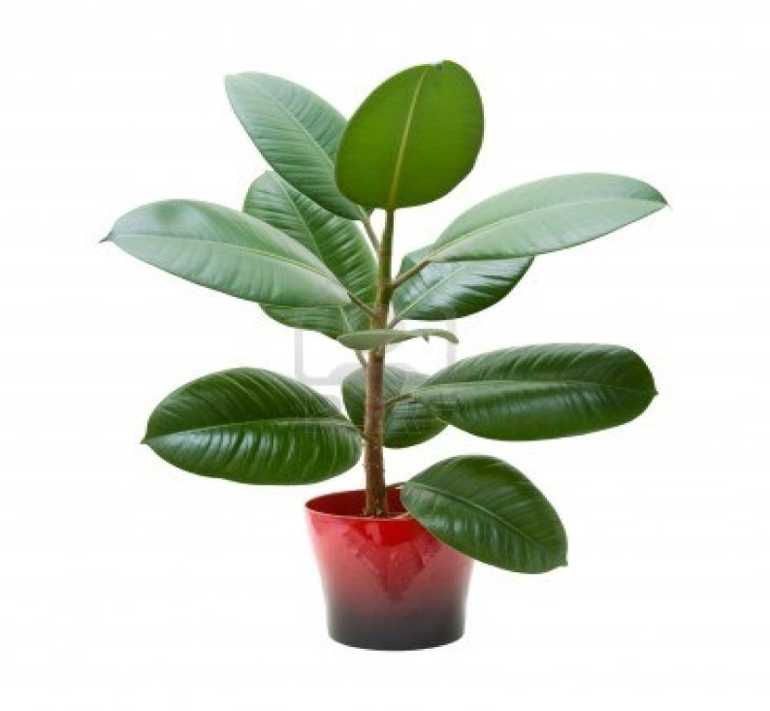
The sun light energy is a part of solar energy.
Light is necessary for the growth of plants.
Plant in a pot grows differently if placed in dark room or in light room.

Slide 21
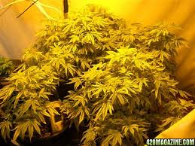
The plant placed in light room shows good development in colour , height and health of a plant.

Slide 22
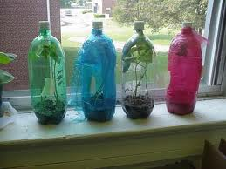
Different colors of light have different effect on the growth of plants. Take red , blue and green cellophane paper . Take some soil in three beaker and some seeds , cover the beaker with cellophane paper . You will observe the difference in the growth and height of the plants.

Slide 23
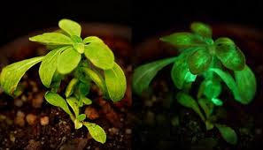
Plants need light mainly for producing food . Green plants contains green substance called chlorophyll. Chlorophyll helps to convert light energy into chemical energy. This chemical energy is stored in plants in the form of food.

