Slide 1
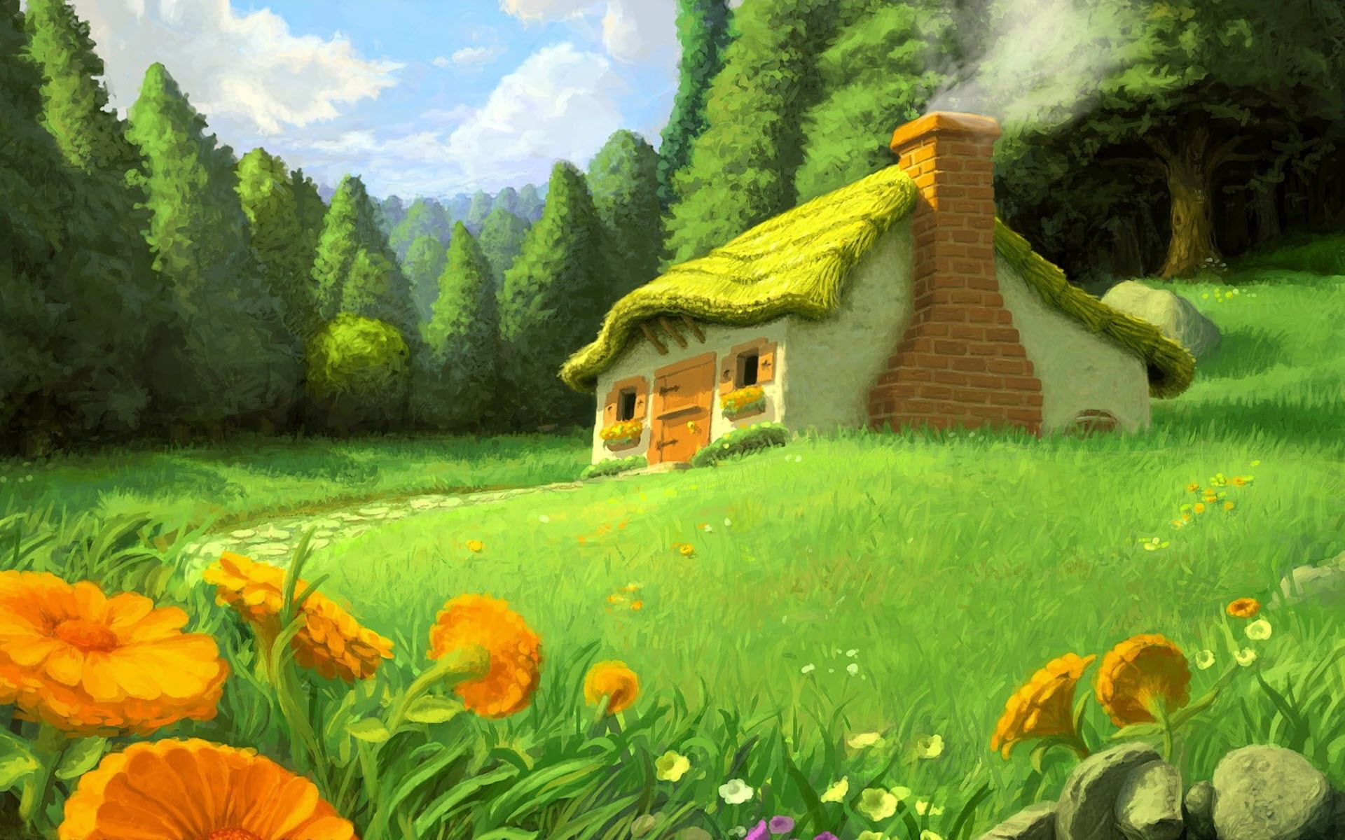
Our Houses

Slide 2
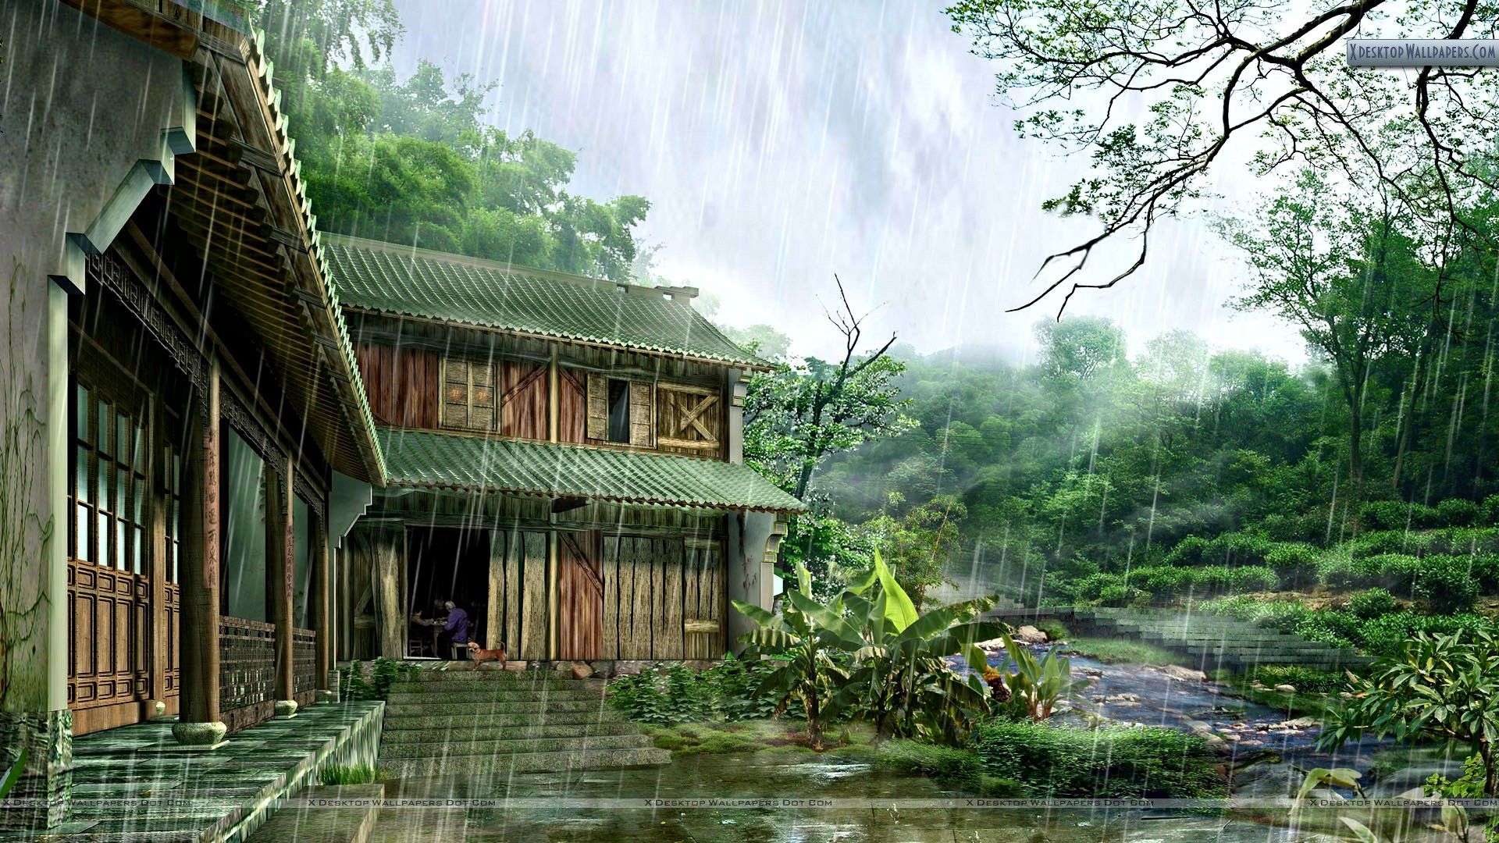
A house protect us from sun, rain and from animals

Slide 3
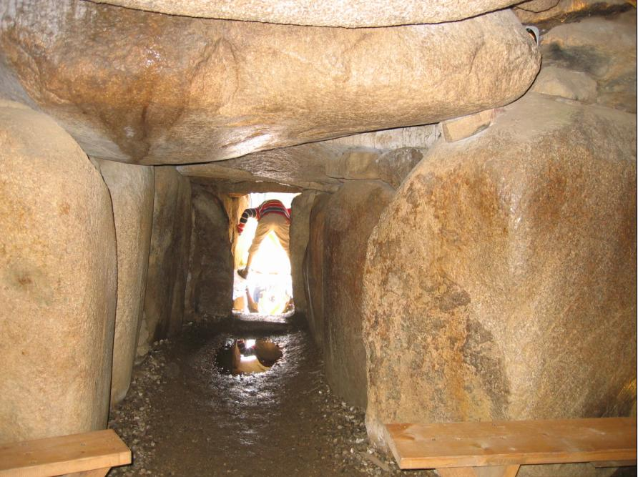
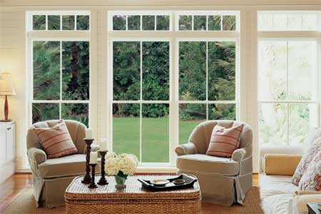
Long time ago man used to live in caves, afterwards he developed and learnt to build houses using various types of materials. We keep windows for light and air to enter.

Slide 4
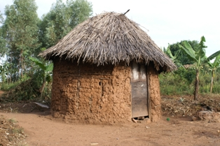
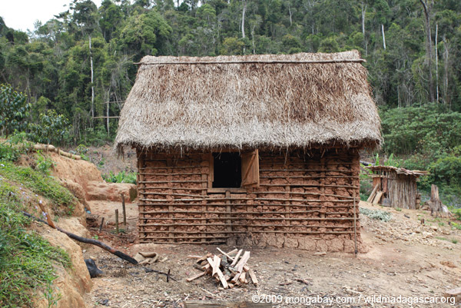
Huts are build by using straw, earth and cowdung

Slide 5
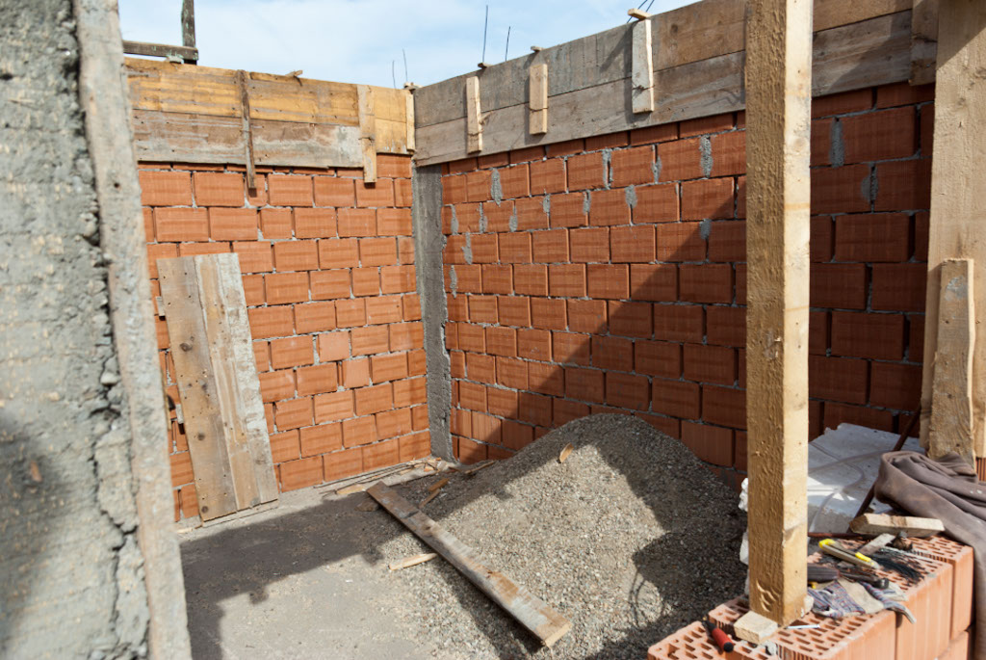
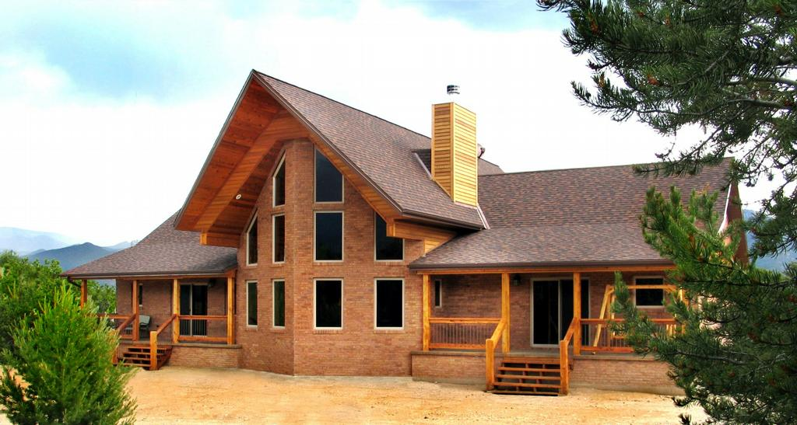
Mud houses are built using stone, bricks, earth and tiles

Slide 6
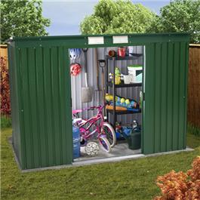
Metal sheet houses are build with sheets of metals, cement or plastic sheets

Slide 7
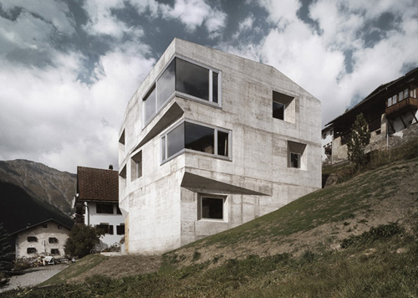
Cement- concrete houses are build using cement, bricks and steel.

Slide 8
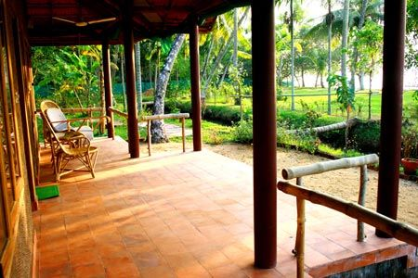
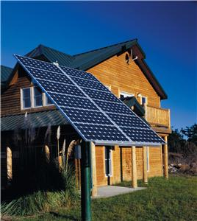
Eco-friendly houses are build so that full use is made of sunlight and electric lights are needed as little as possible.

Slide 9
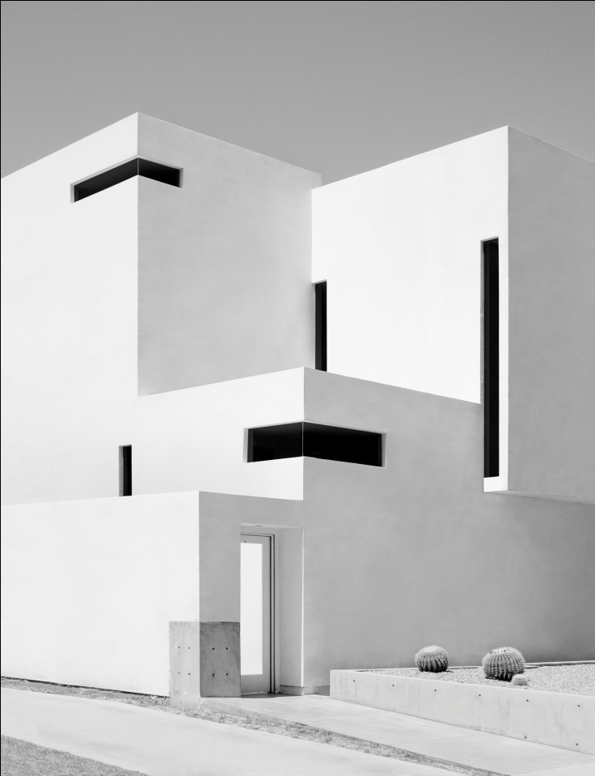
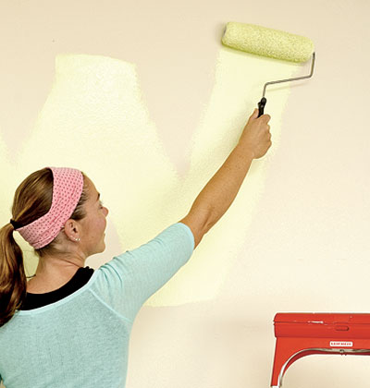
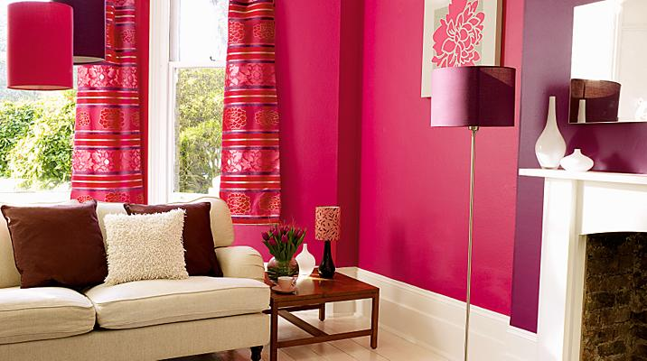
We get different types of paints in market such as whitewash, distemper, oil paint, cement paint, plastic paint

Slide 10
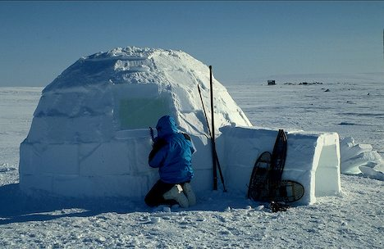
The people who live in the more snowy areas (Tundra) build snow houses called Igloo

Slide 11
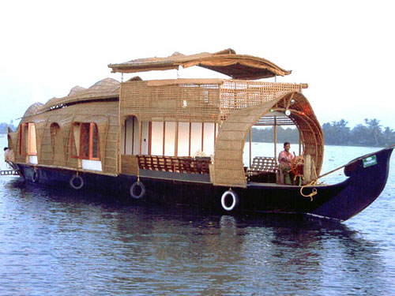
In the areas where rivers and lakes are there people live in big boats known as Houseboat

Slide 12
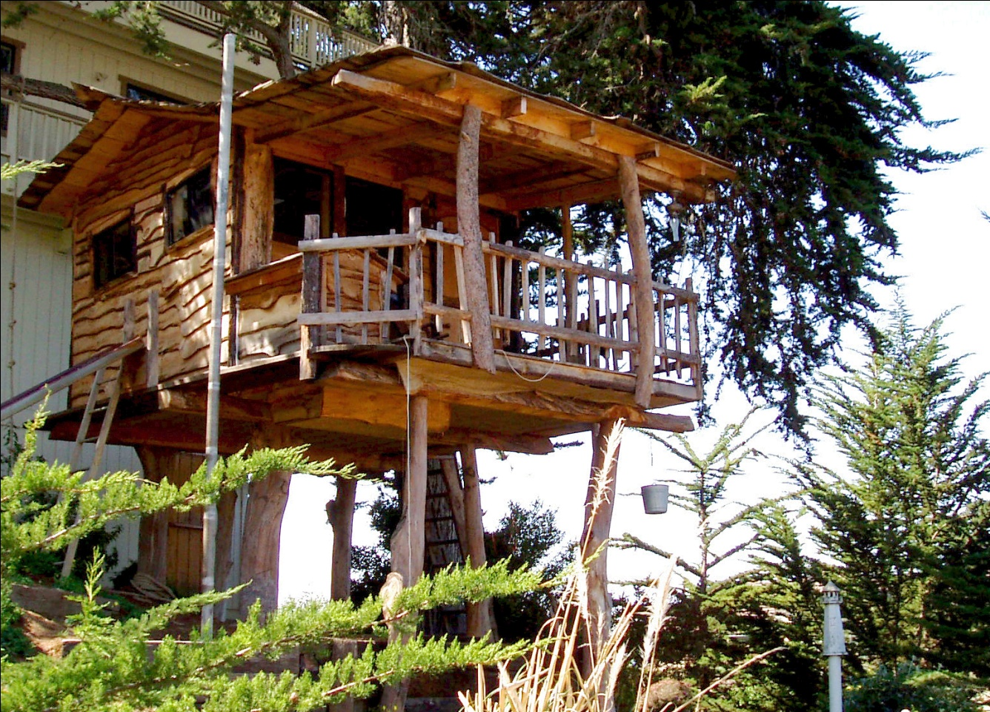
In muddy areas people cannot build their houses on land so they build it at a height.

Slide 13
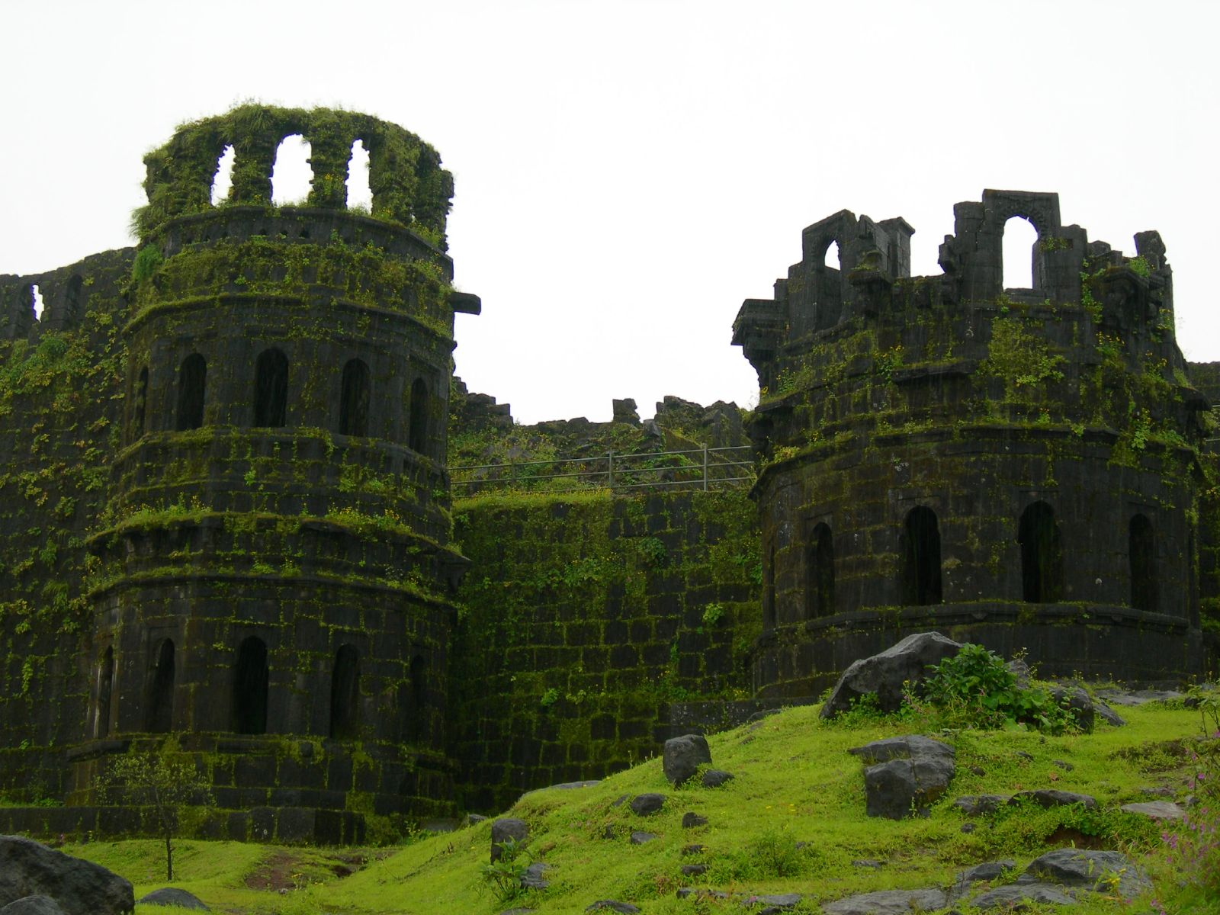
India has many historical monuments, forts and temples. Forts were the big houses of kings. We should not write or scribble on the walls of these places.

Slide 14

www.erc-pune.org

